Slide 1
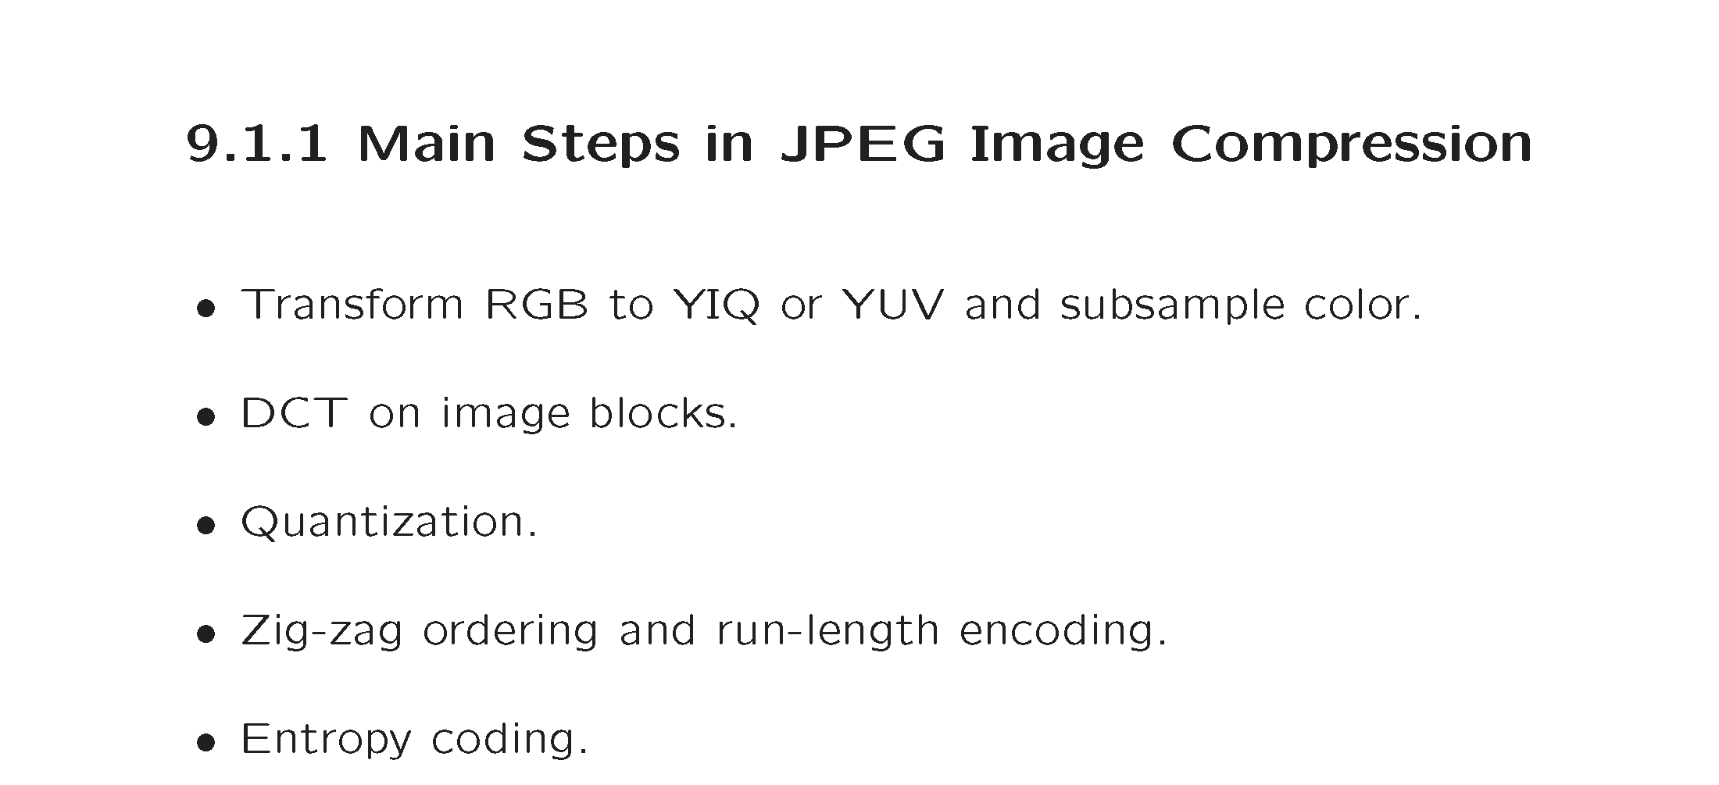
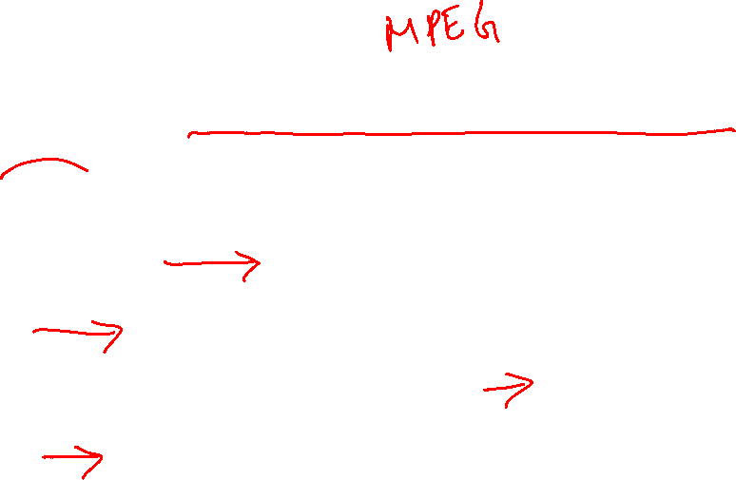

Slide 2
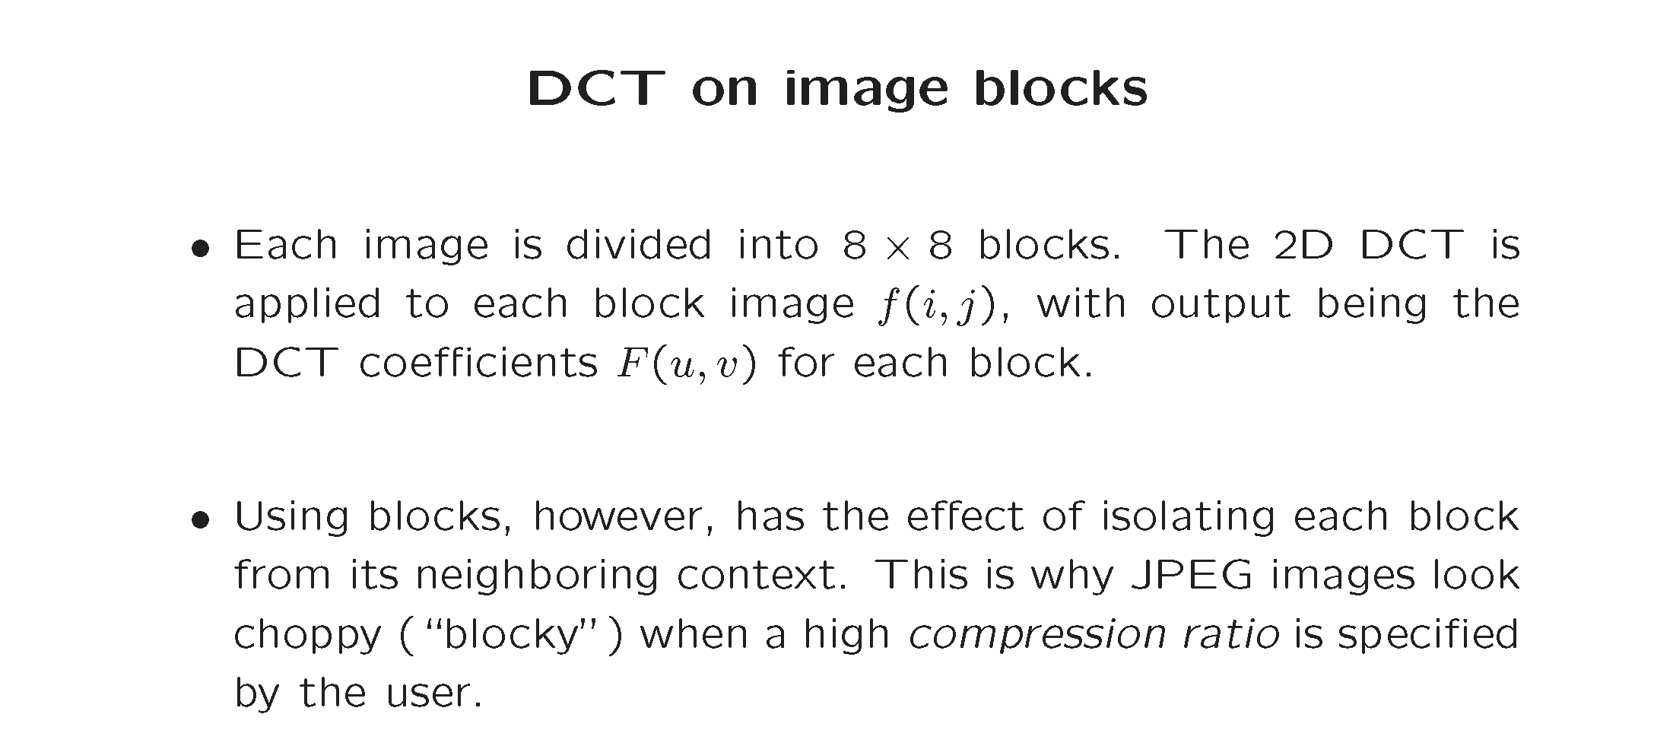

Slide 3
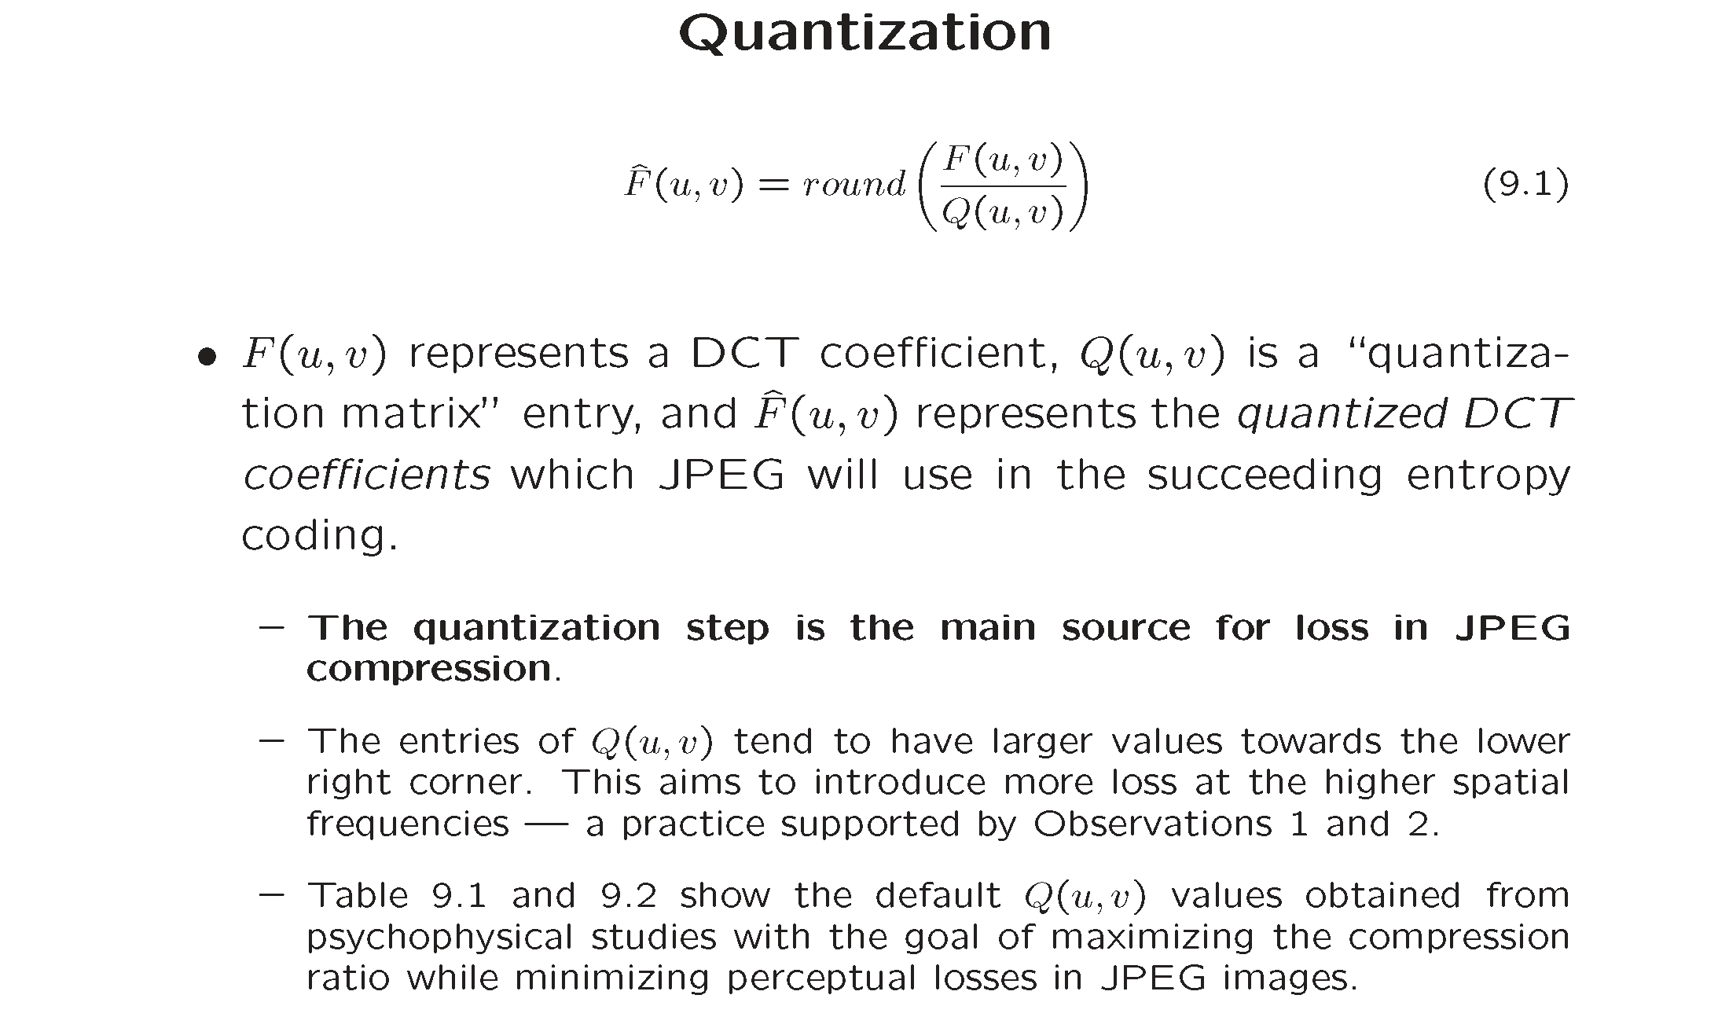

Slide 4
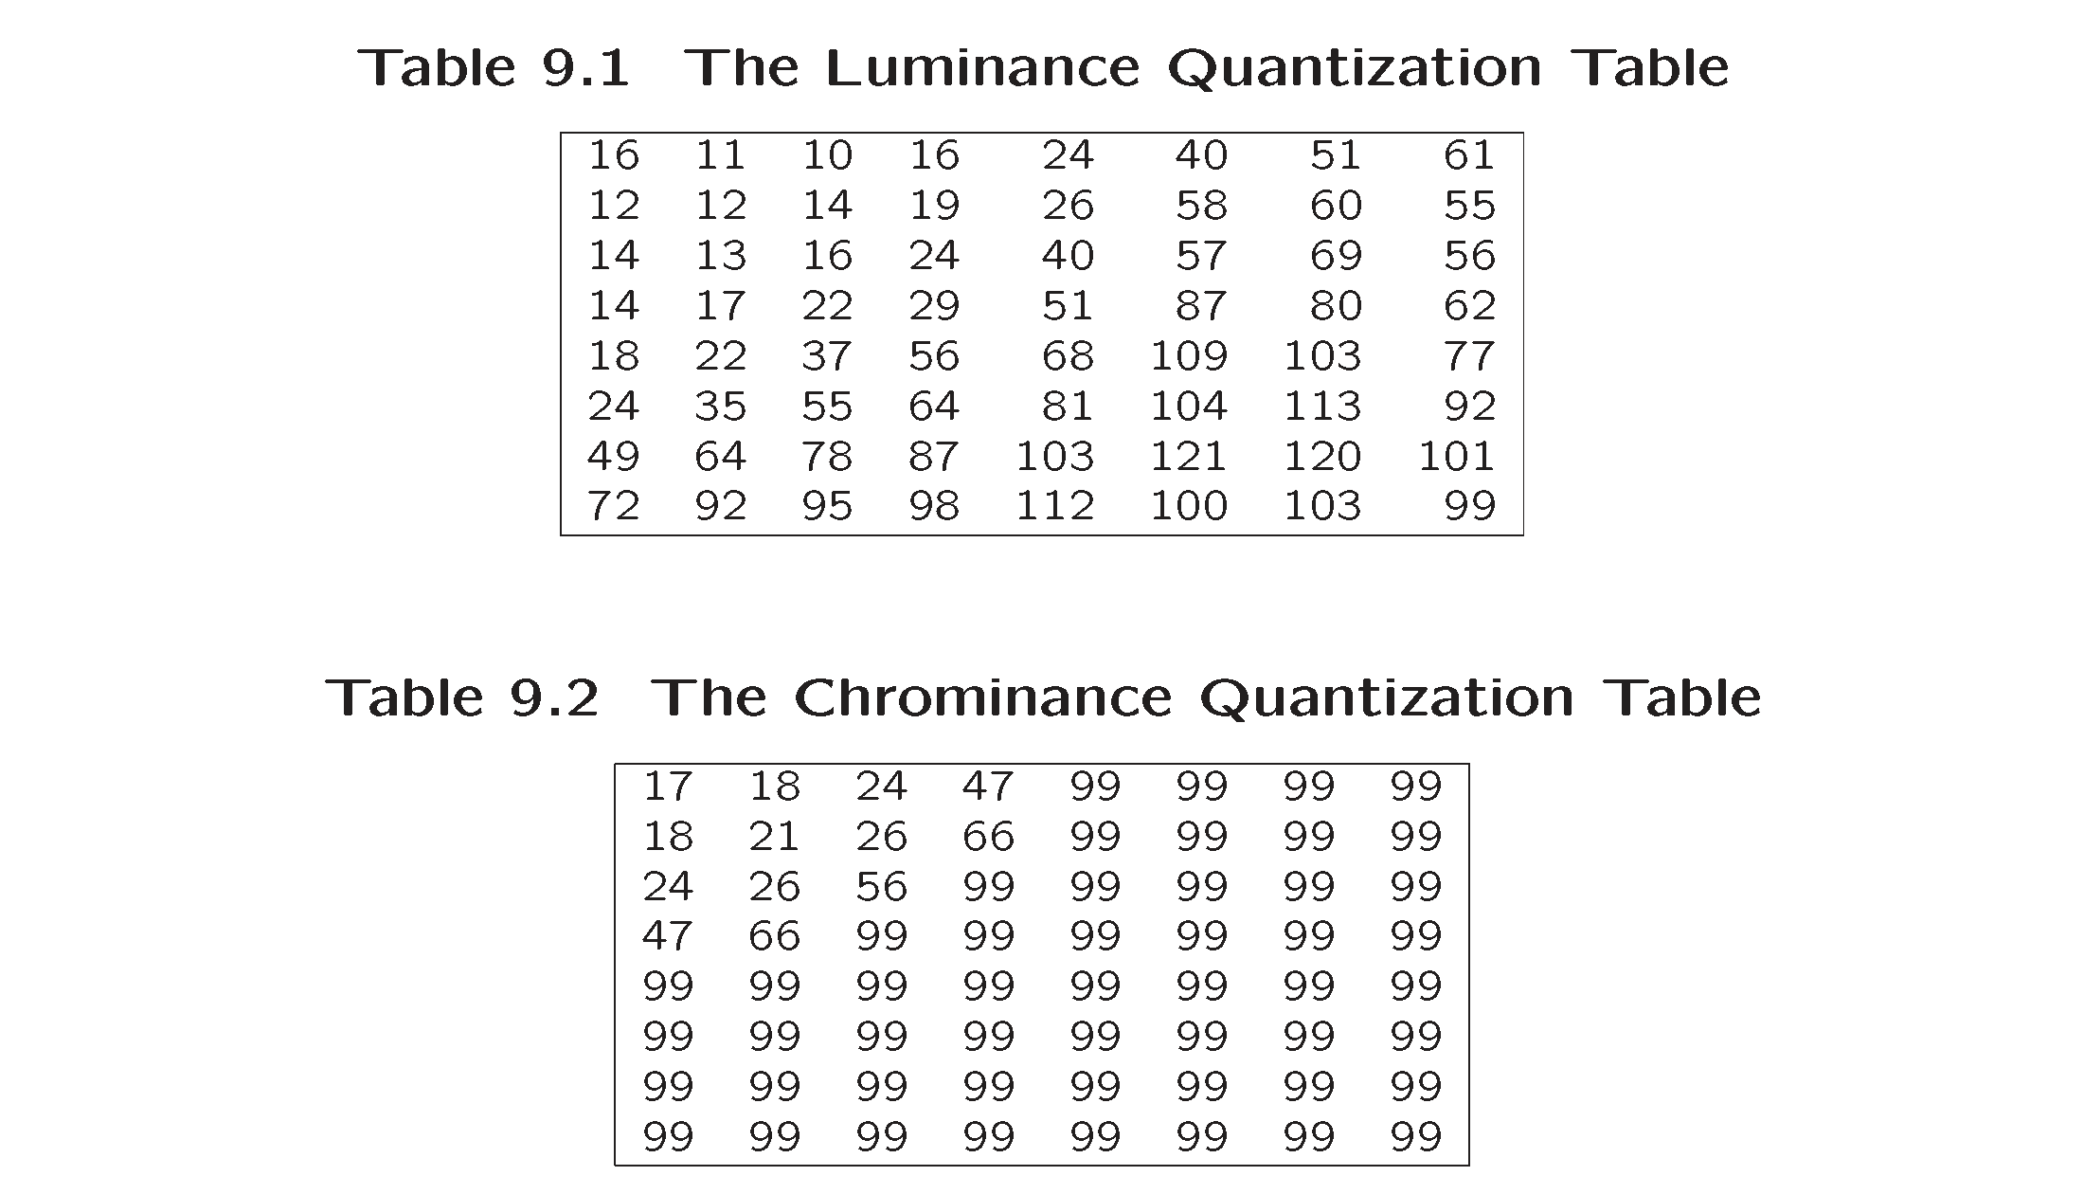
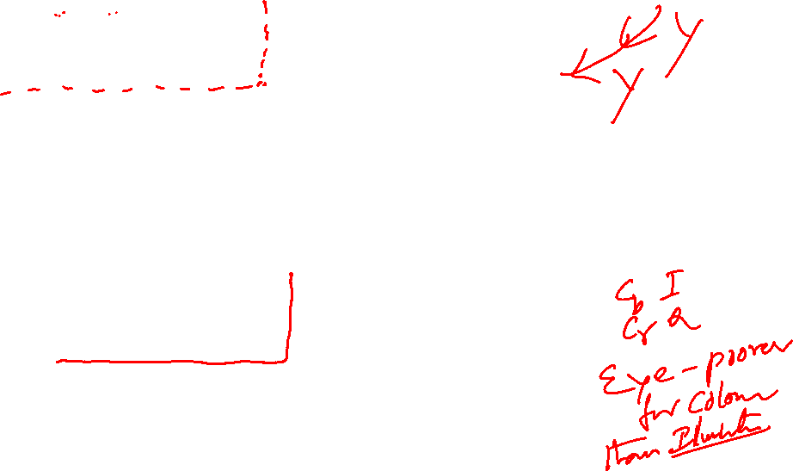

Slide 5
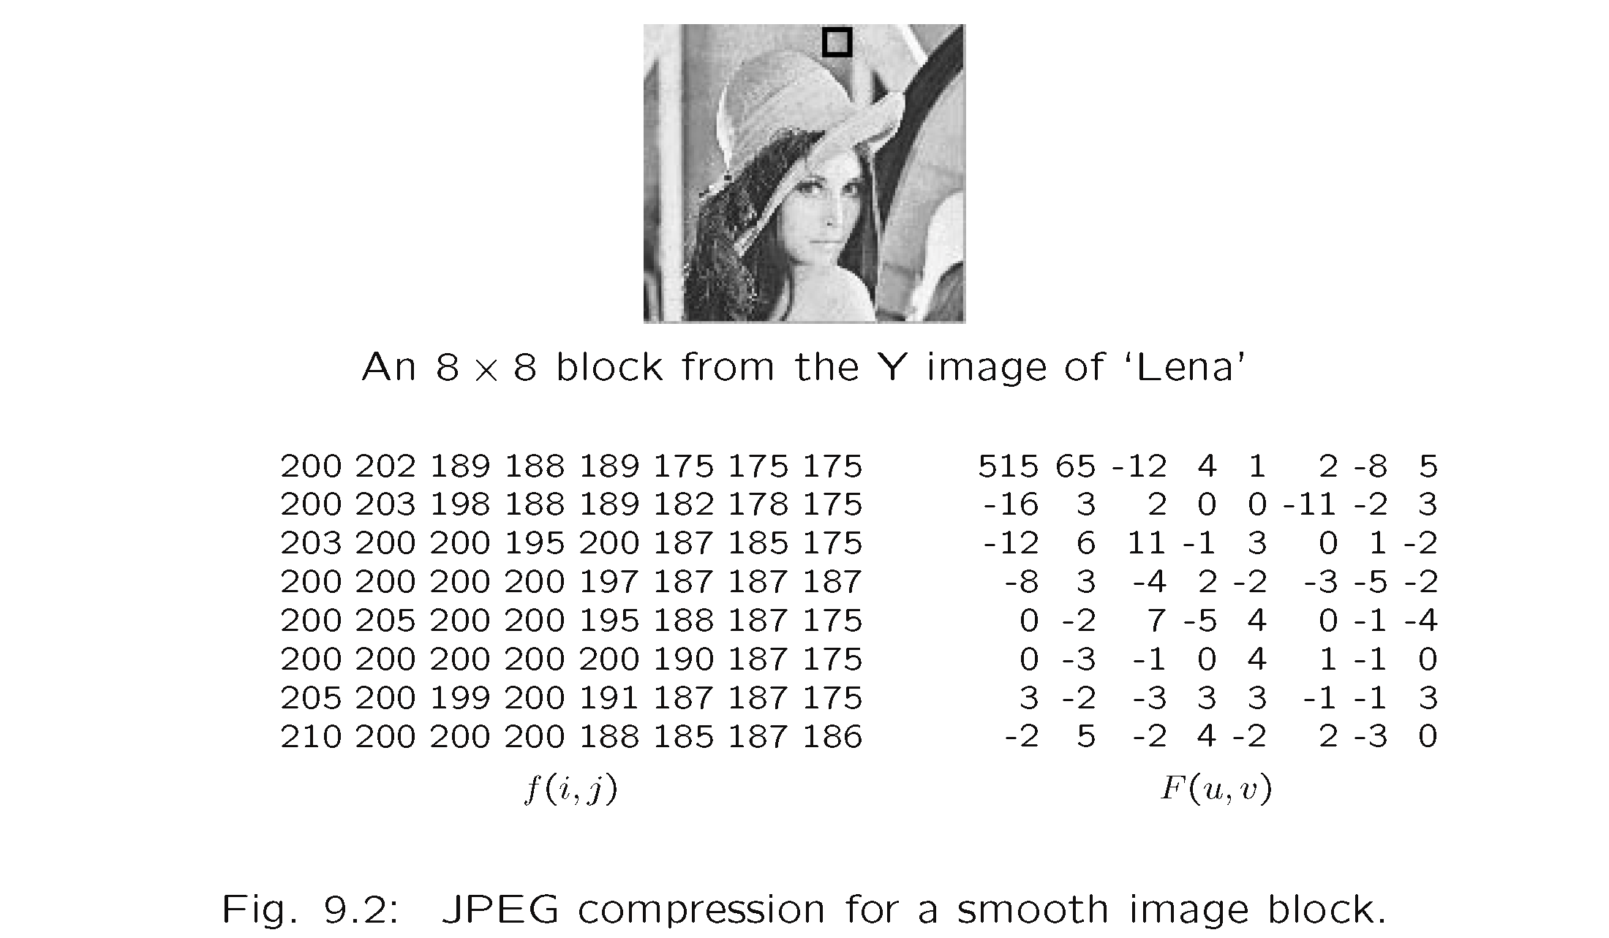
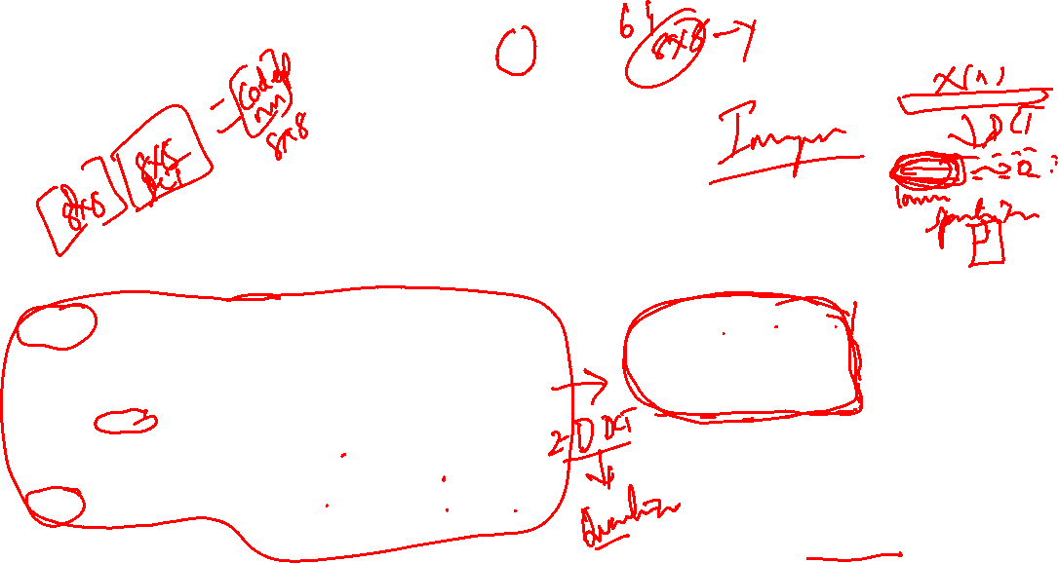

Slide 6
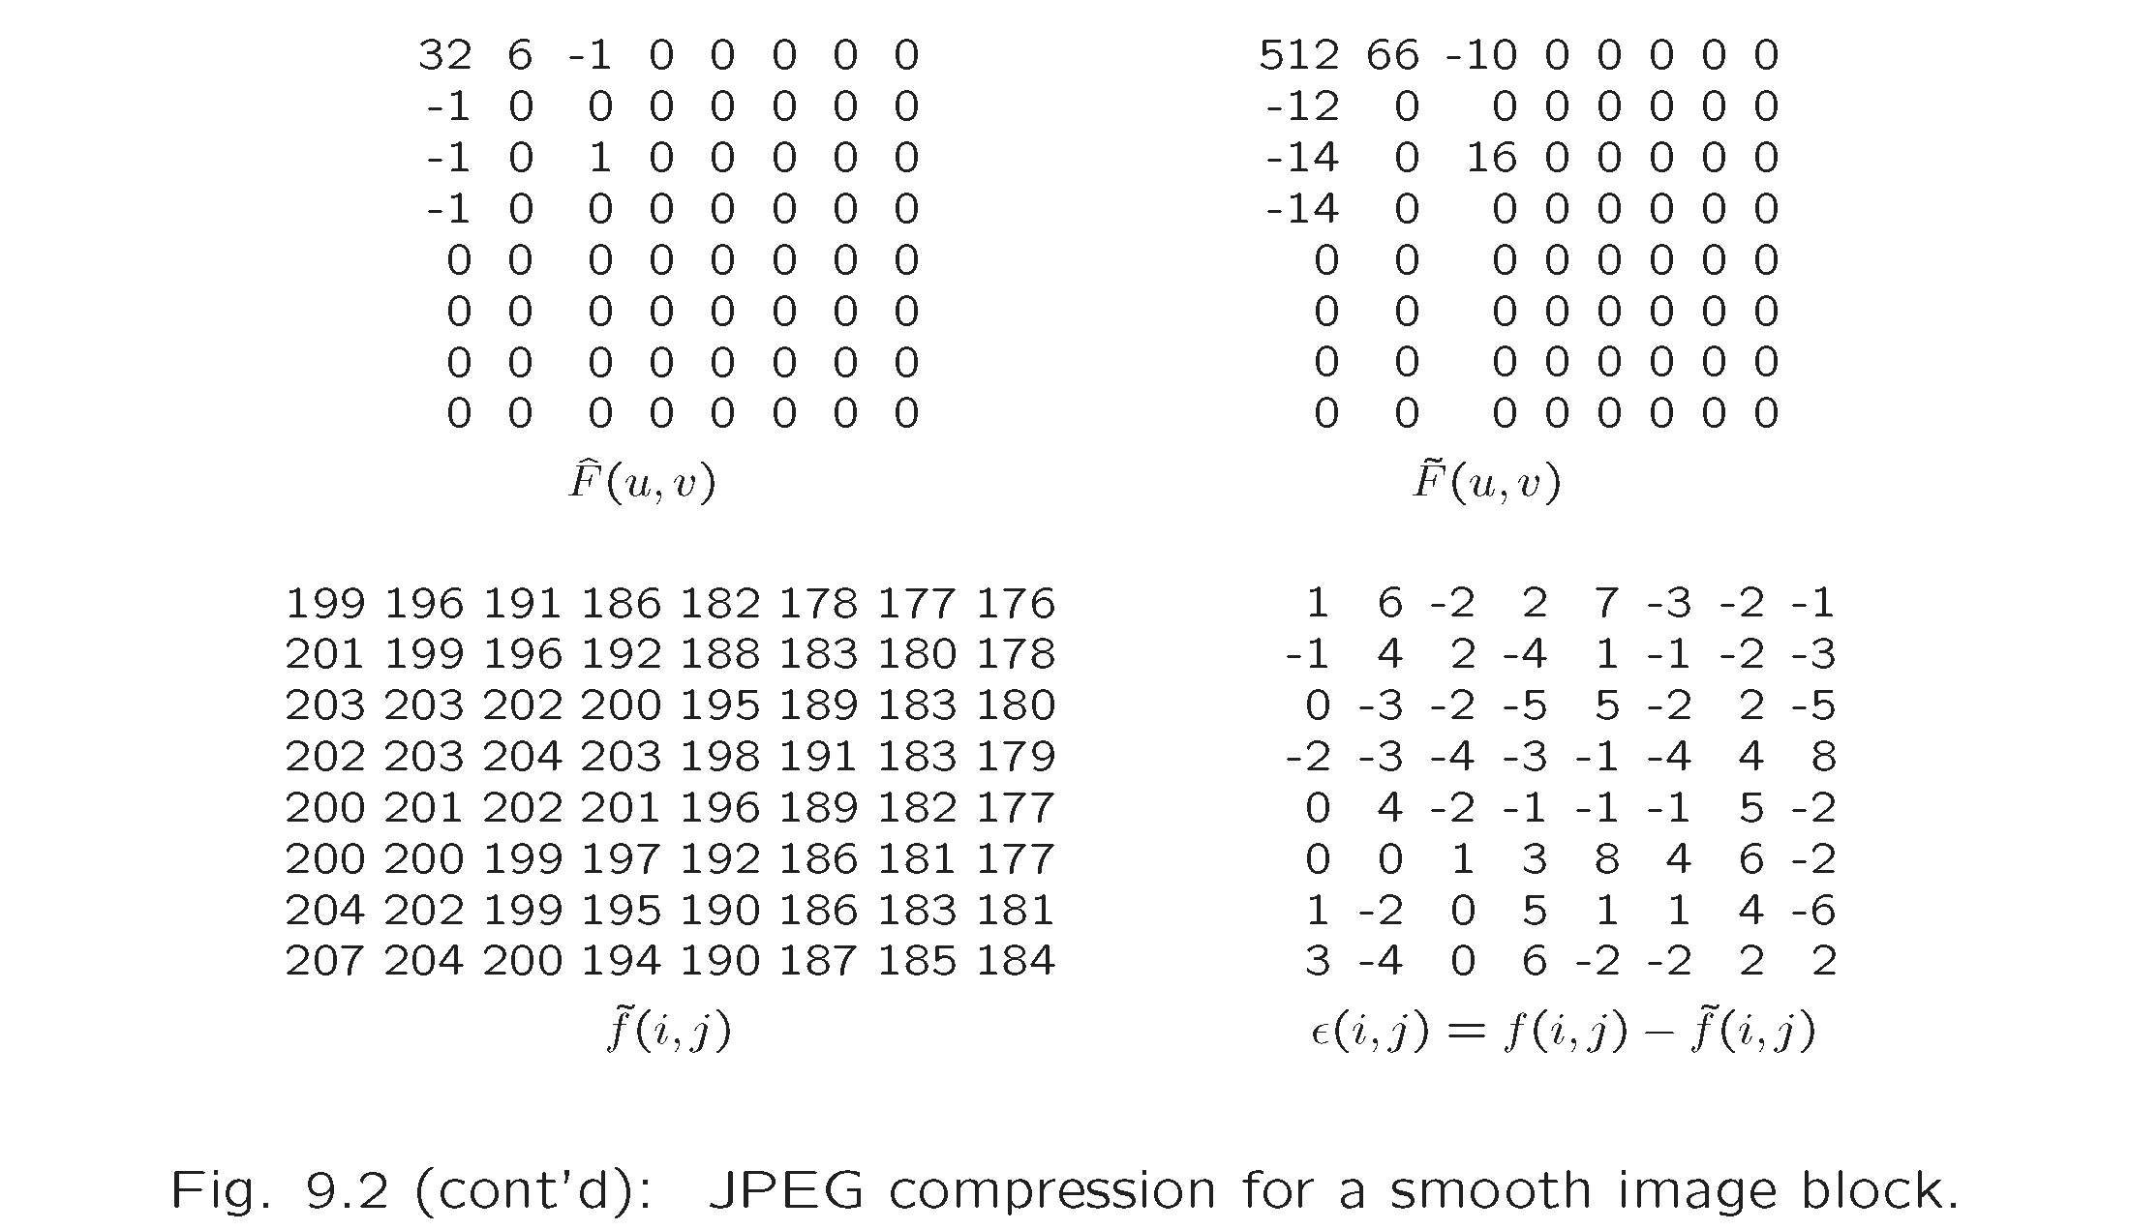
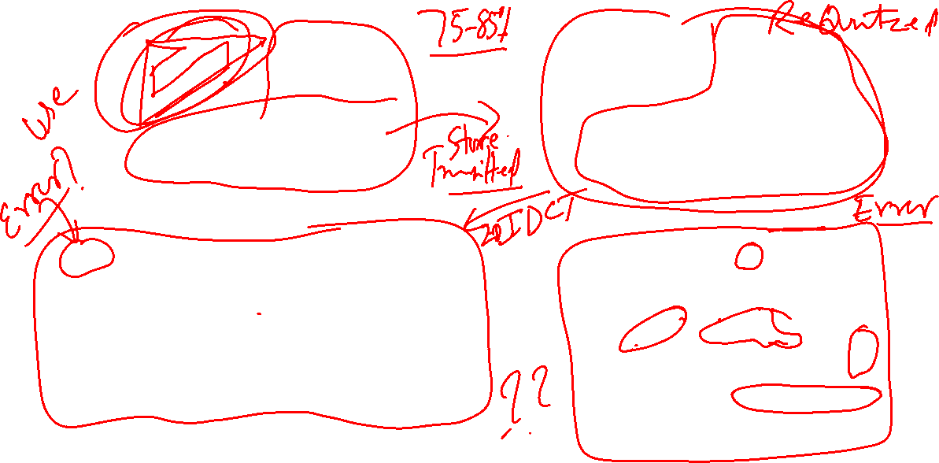

Slide 7
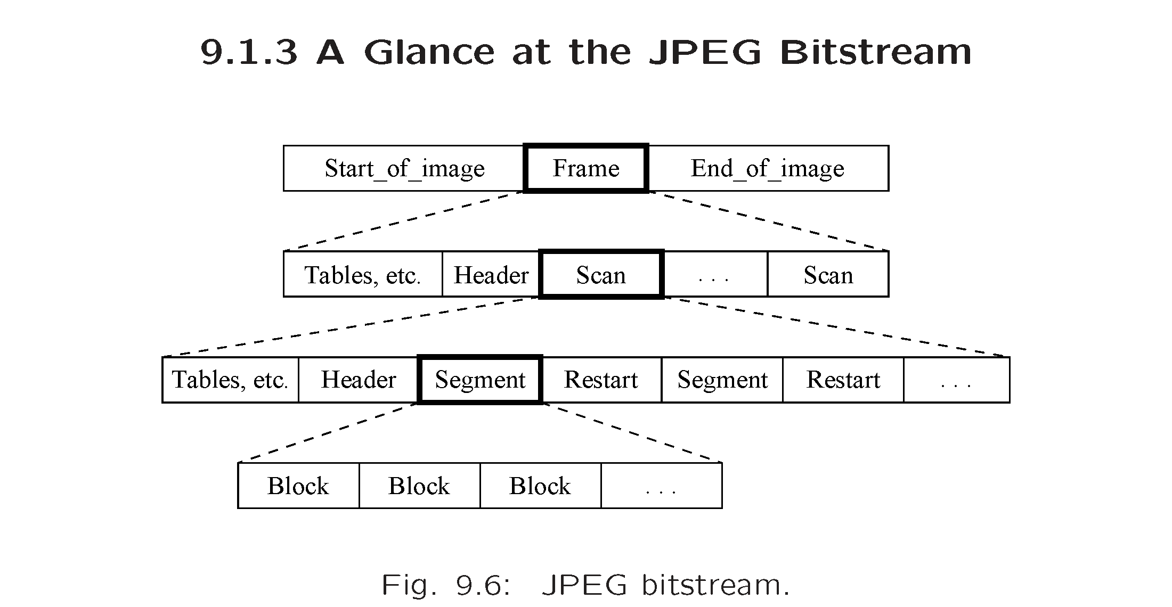


Slide 8
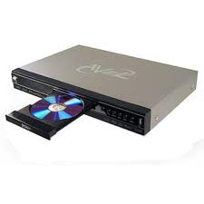
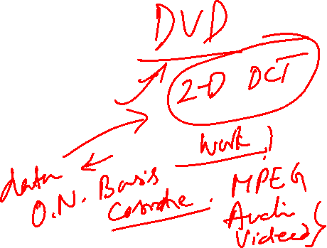
This is what we finally end up making

Slide 9
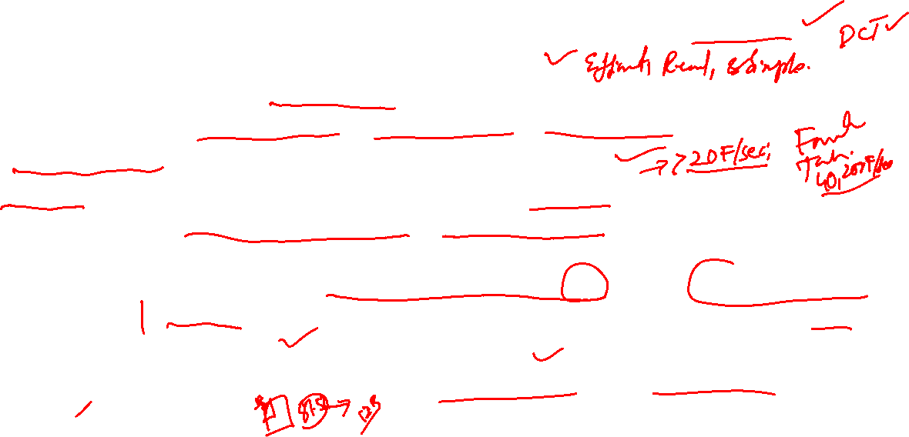
Summary of making the DVD
High orders of compression needed, yet should preserve quality.
Use Transform techniques, In particular DCT.
Use systematic steps (Algorithms) compatible with Image Processing requirements (Quantization, Lookup tables, File format, etc).
Encapsulate the entire process in a package: DVD.
E & C, CS. A little bit of Psychology of Vision (PoV) & Human Limitations used to an advantage ( small errors are not registered by human vision).
It works because: Appropriate mix of Maths (LA ) using DCT as a Basis, Projections, EV-EV or real symmetric matrix, Orthonormal Basis (DCT) for representing Data.
(Compact Coding (DATA) , yet Distributed Errors. Amazing capacity of DCT.)

Slide 10
More Applications using various Concepts of Linear Algebra
Dr Ashok Rao
Former Head, Network Project, CEDT, IISc, Bangalore-560012, India
< ashokrao.mys@gmail.com >

Slide 11
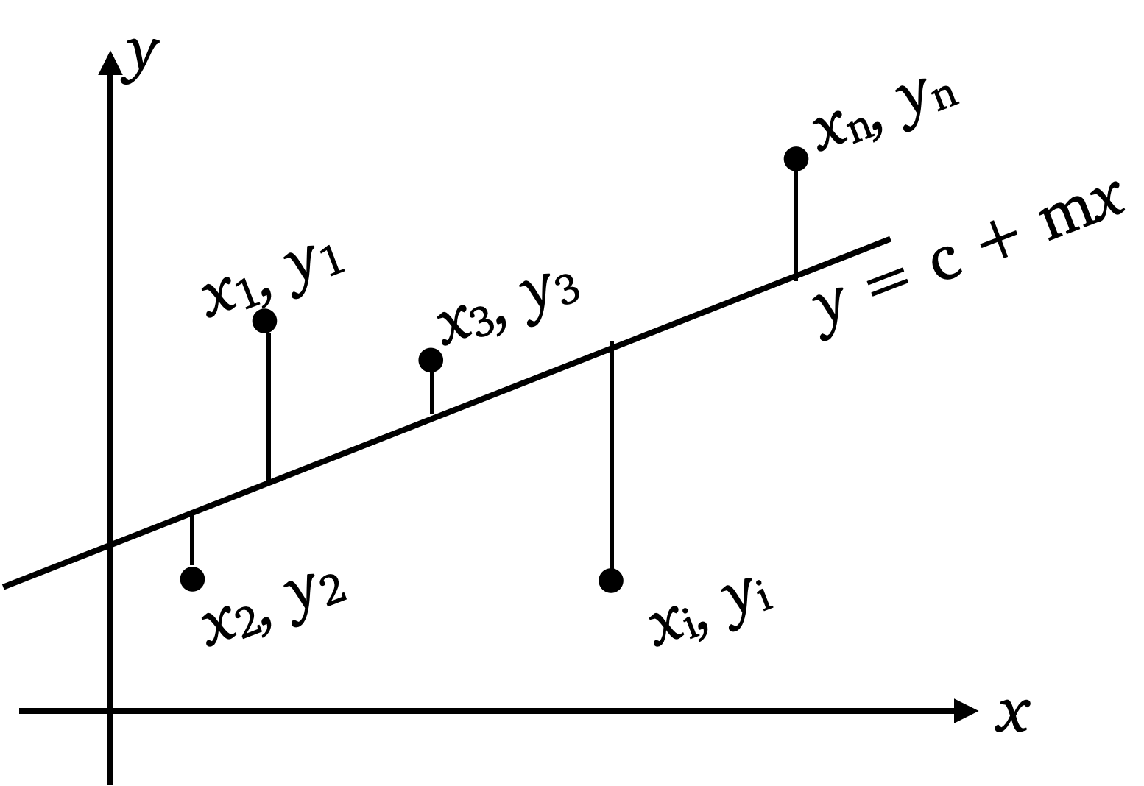
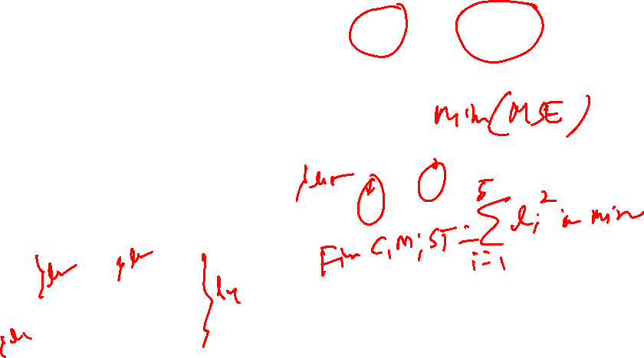
Back to LSE or MSE

Slide 12
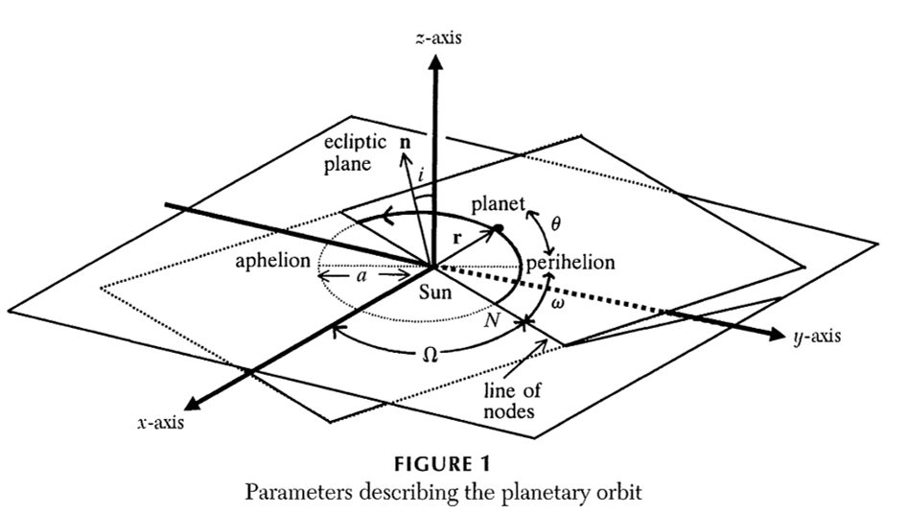
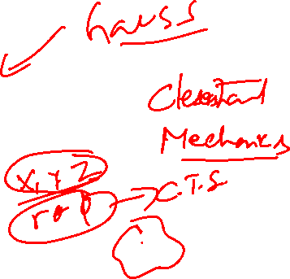
Back to LSE or MSE
Image Courtesy:
https://www.actuaries.digital/2021/03/31/gauss-least-squares-and-the-missing-planet/

Slide 13

Let A be an m x n matrix. The following statements are logically equivalent:
The equation Ax = b has a unique least-squares solution for each b in R^{m}
The columns of A are linearly independent.
The matrix A^{T}A is invertible.
When these statements are true, the least-squares solution is given by
When a least-squares solution is used to produce as an approximation to b, the distance from b to is called the least-squares error of this approximation.

Slide 14
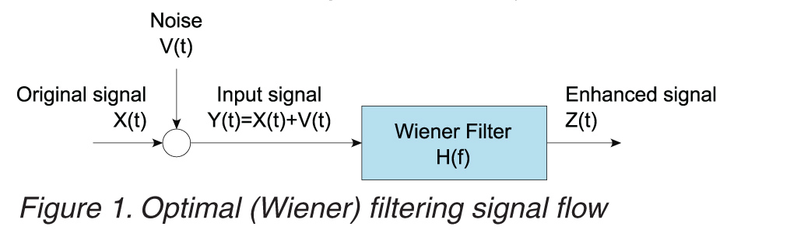

Most impressive application of LSE
Image Courtesy: https://i.sstatic.net/w3xba.jpg

Slide 15
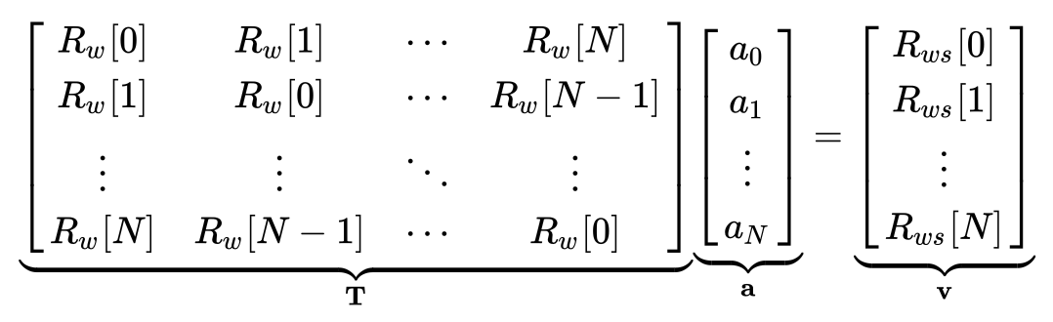
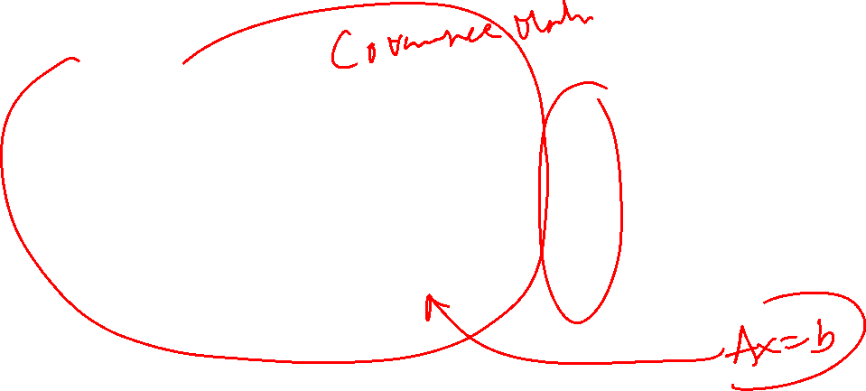
Most impressive application of LSE
Image Courtesy: https://en.wikipedia.org/wiki/Wiener_filter

Slide 16
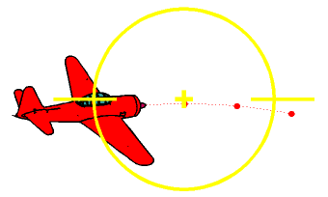
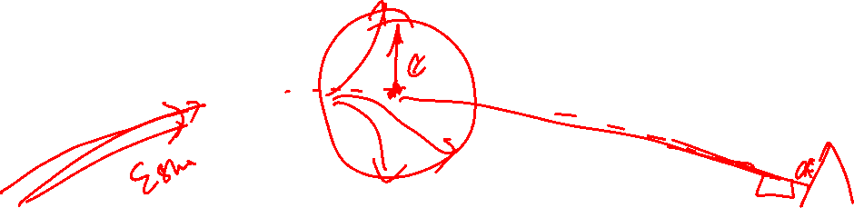
Most impressive application of LSE
If the target moves across the course of the fighter, a certain amount of lead has to be taken into account: One has to fire at the point in space where the target will be when the projectiles arrive. The fighter therefore has to fly a curve while firing, i.e. it is turning at some rate. Evidently, there would be no problem if the projectiles arrived instantaneously. Of course they do not, but it is advantageous to reduce the time of flight as much as possible, by using guns with a high muzzle velocity.
Image Courtesy: https://www.oocities.org/capecanaveral/hangar/8217/fgun/fgun-th.html

Slide 17
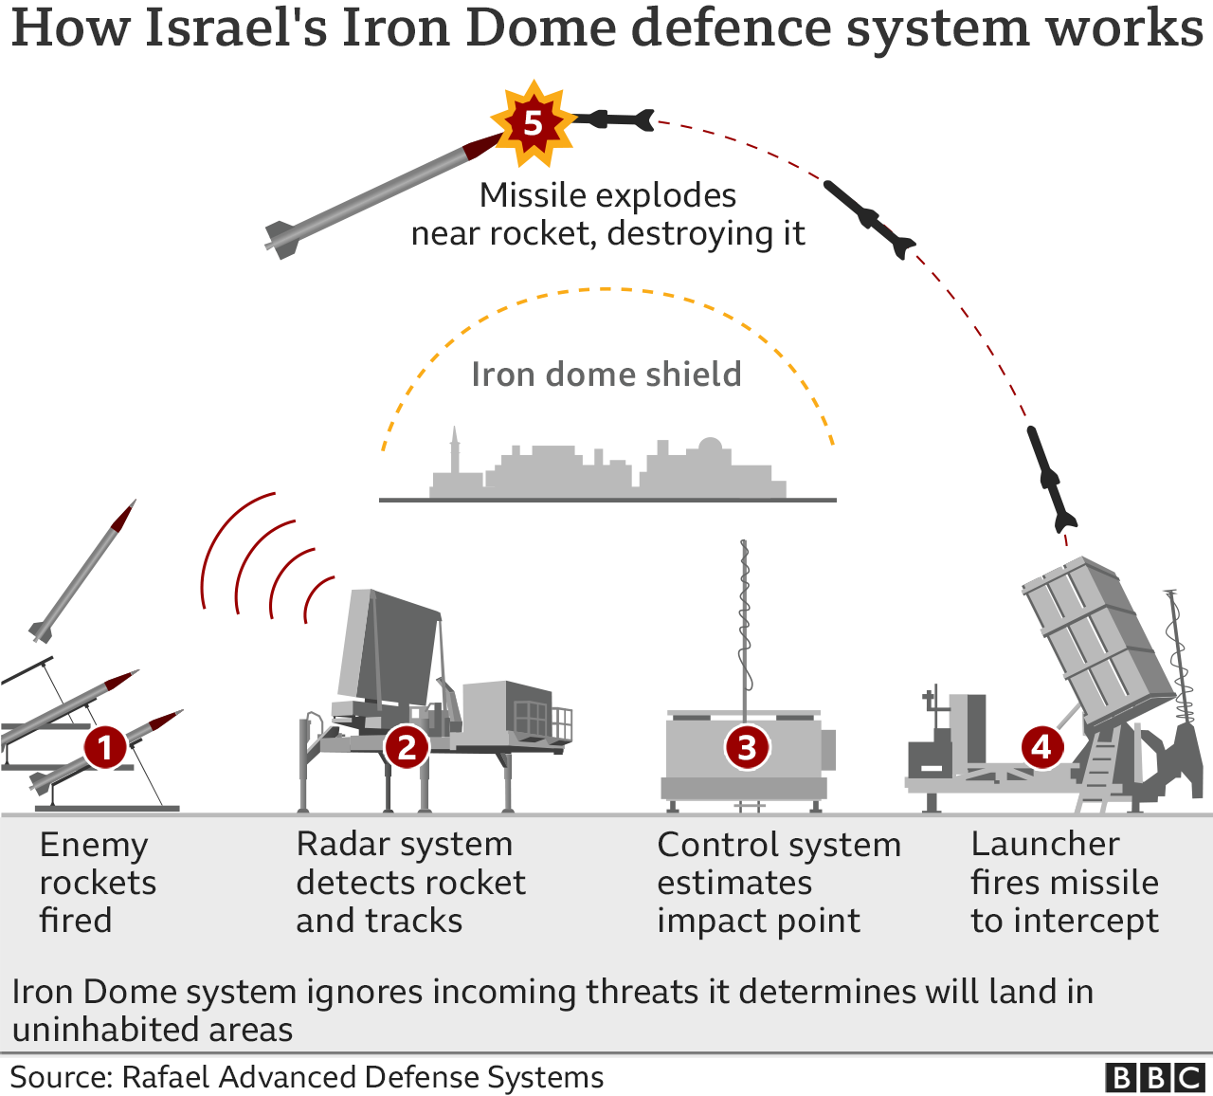
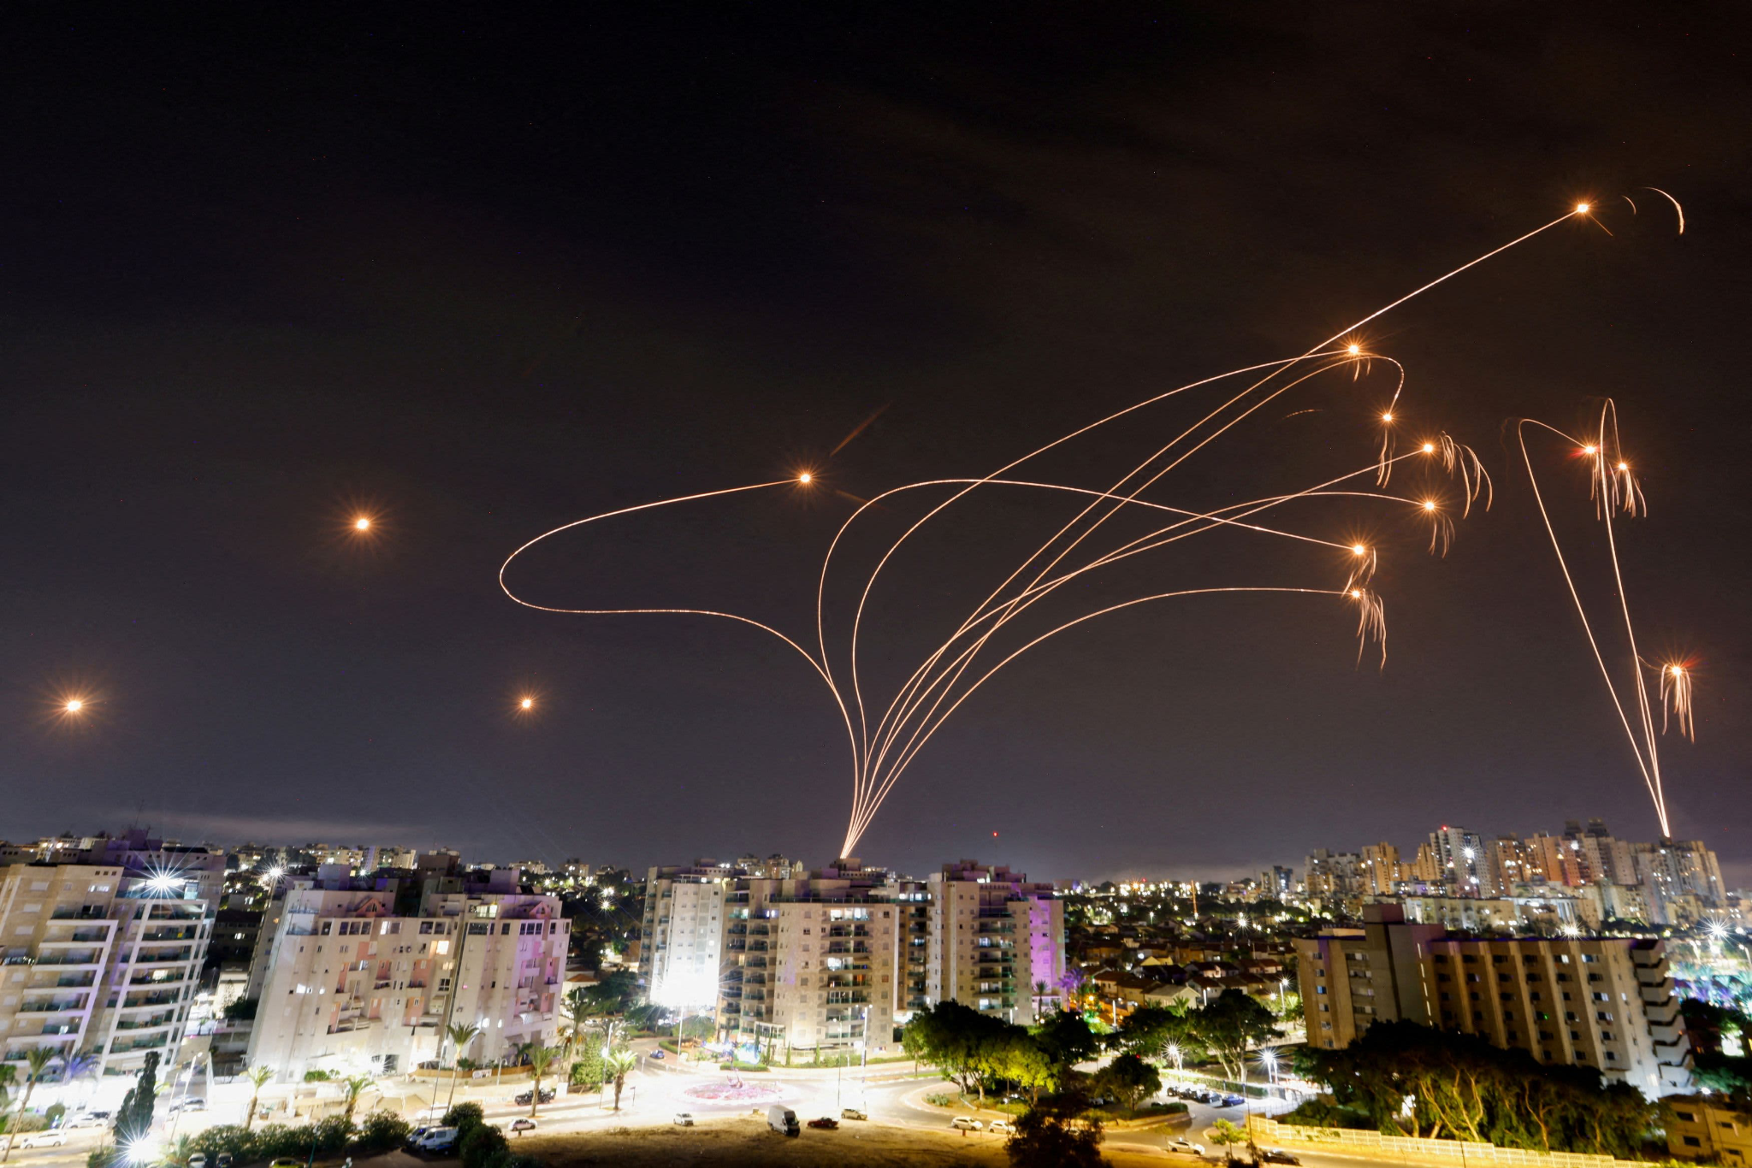

Focus on Smart Electronic Systems (AI-ML-2020, still uses LMS, or MSE criteria)
Image Source: https://www.france24.com/en/middle-east/20240414-iron-dome-air-defence-system-israel-s-key-anti-missile-shield
Image Source: https://www.bbc.com/news/world-middle-east-20385306

Slide 18
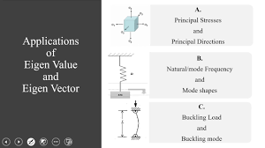

Very Important Concept in LA is Eigen Value-Eigen Vector

Slide 19
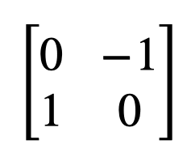
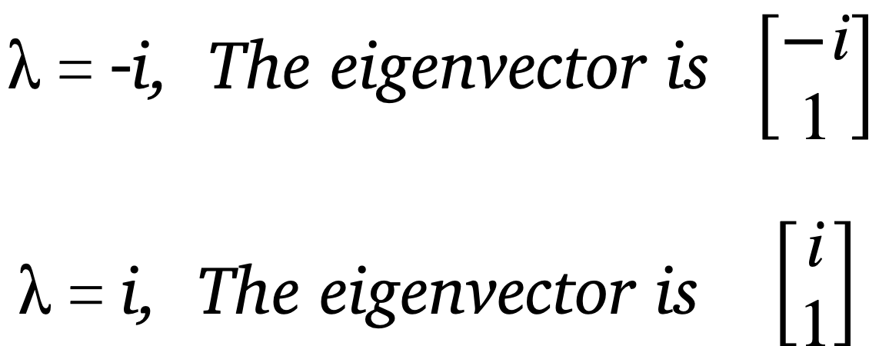
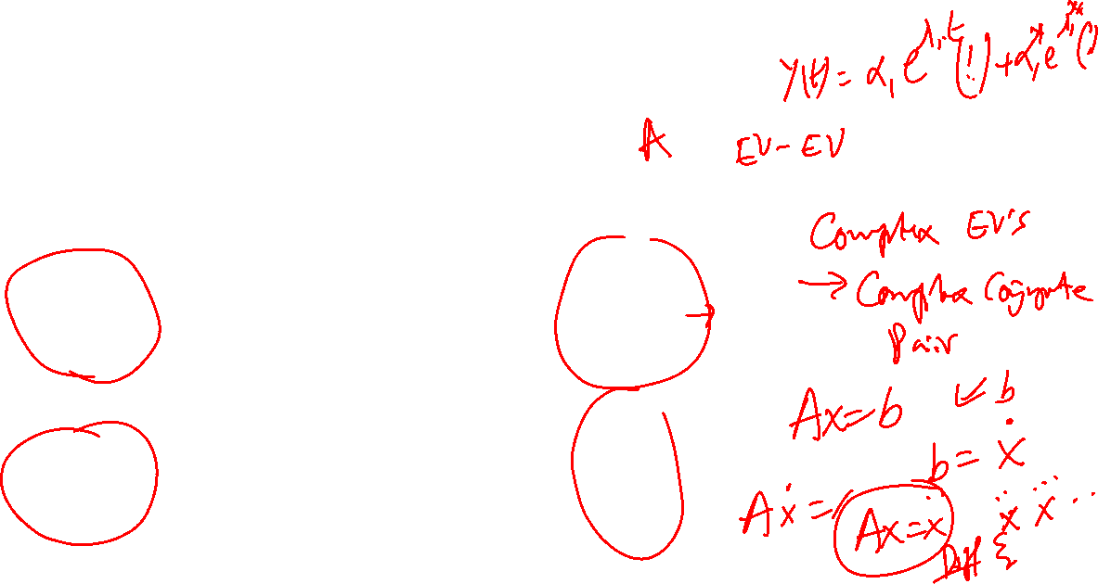
Eigen Value-Eigen Vector
Consider the following matrix:

Slide 20
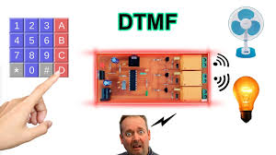
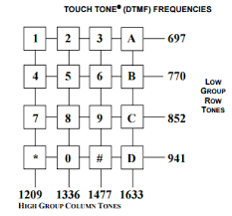
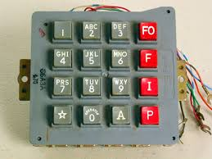
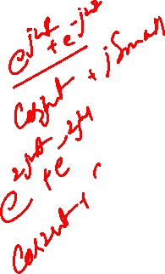
How to convert LA facts into a Product?

Slide 21
What all of you use as much as or more than Mobile Phone
While we just Understood that whenever we operate a Mobile Phone, we are exciting different Eigen Values (Complex Conjugate Pairs) to get started, there is,
An even more valuable Linear Algebra based action which determines much of our progress or mobility day-in-day-out.
That is also a Eigen Value-Eigen Vector problem with some “ Modifications”.

Slide 22
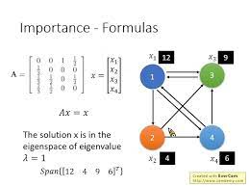

One of most Modern of Application; Almost Universal and Dominant

Slide 23
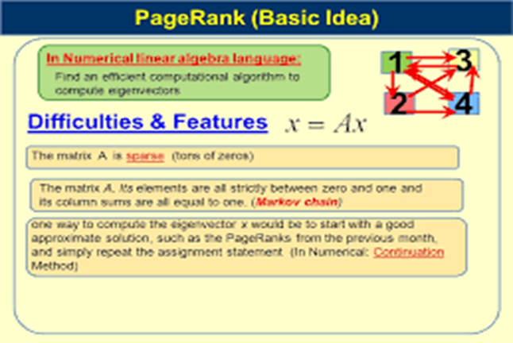
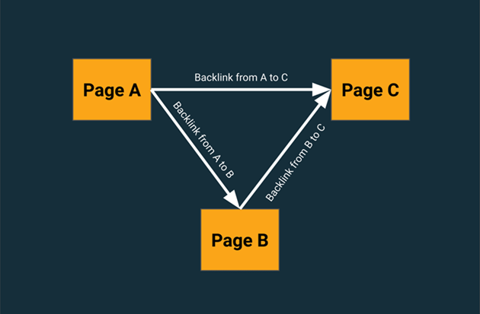
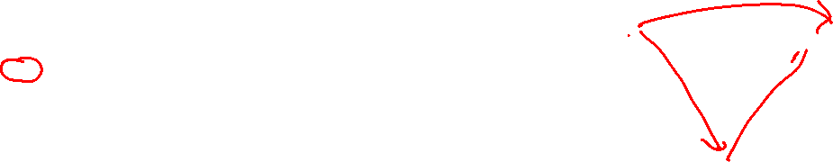
What all of you do when Searching

Slide 24
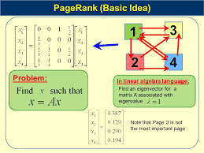
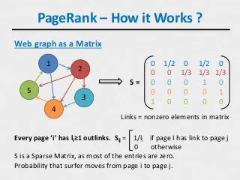
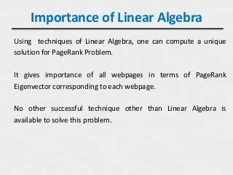
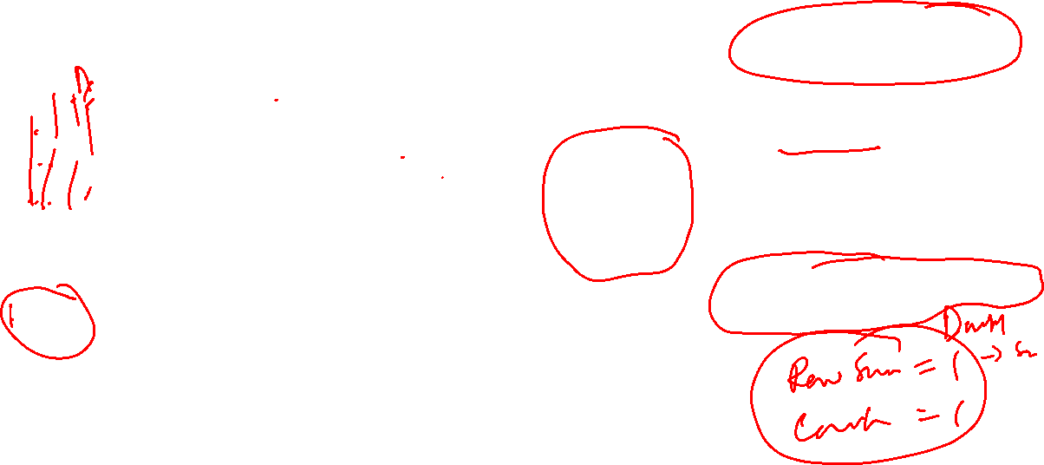
Graph representation+ LA & Algorithm

Slide 25
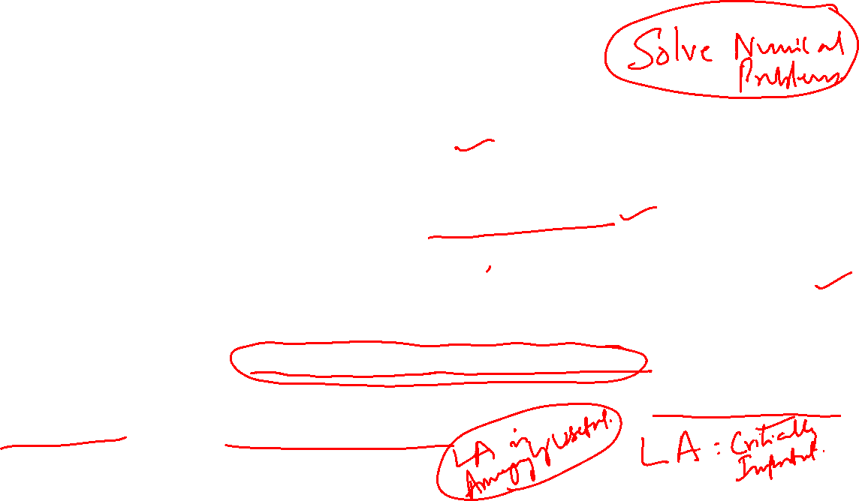
Conclusion
The World (Both Scientific and Social) is filled with Applications using LA concepts.
As the World Moves towards DATA centric life, more applications using LA is only to be expected.
While concepts is what we learn, Numerical Linear Algebra and Algorithmic Linear Algebra is what is eventually used.
It is safe to say that Future will be dominated by combinations of LA+ Statistics+ Optimization.
This combination has another modern label called MACHINE LEARNING or DATA ANALYTICS.

